Slide 1
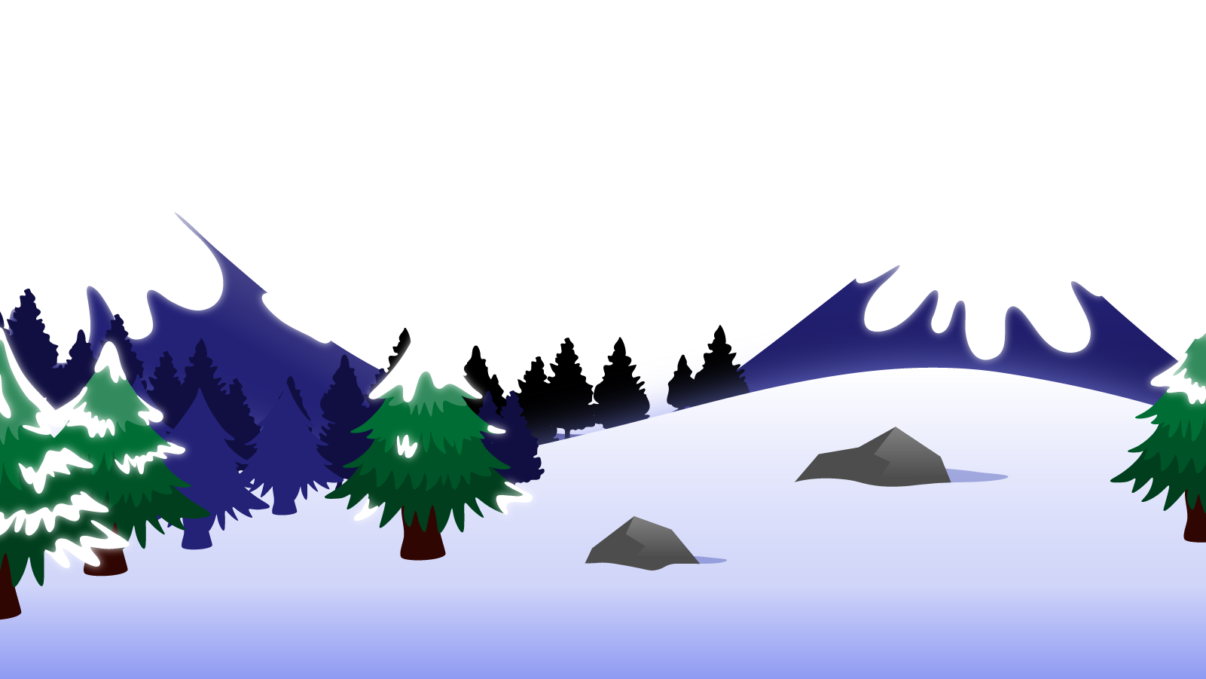
How to Use this Powerpoint
These slides have been designed to be used in Powerpoint as a Slide Show.
There are text and images that will overlap and cause confusion, if used in desktop mode.
To open this in Slide Show mode, please click “Slide Show” on the menu above and then “From Beginning”.
Thank you from the Emile Team.
If you have any feedback, or would just like to say “hello”, please email us at: hello@emile-education.com

Slide 2
Semi-colons, colons and dashes to mark between independent clauses

Slide 3
A clause is a group of words that contains
a subject and a verb.

Slide 4
There are two types of clauses:
Independent clauses.
Subordinate clauses.
If a clause contains a complete thought, then it is an independent clause.
If a clause does not contain a complete clause, then it is a subordinate clause.
(Independent clauses are sometimes called “main” clauses.)
(A relative clause is a type of subordinate clause.)

Slide 5
Subordinate clause
Incomplete thought
Independent clause
Complete thought

Slide 6
Let’s look at an example:
Because Emile is awesome.
“Emile” is the subject.
“is” is the verb.
What is the subject?
What is the verb?
Is this a complete thought?
No. It’s not a complete thought because some information is missing.
It’s a subordinate clause and not an independent clause.

Slide 7
Let’s look at another example:
Until the adult did it.
“adult” is the subject.
“did” is the verb.
What is the subject?
What is the verb?
Is this a complete thought?
No. It’s a NOT complete thought because some information is missing.
It’s a subordinate clause.

Slide 8
Independent clause or subordinate clause
Until they did it!
It’s an incomplete thought
so it’s a subordinate clause.
After they got on the train,
It’s an incomplete thought
so it’s a subordinate clause.
They got on the train at the station.
It’s a complete thought
so it’s an independent (or main) clause.

Slide 9
Independent clause or subordinate clause?
Aimee landed the rocket.
It’s a complete thought
so it’s an independent clause.
That was in the rocket.
It’s an incomplete thought
so it’s a subordinate clause.
If you go on Saturday
It’s an incomplete thought
so it’s a subordinate clause.

Slide 10
1. Sentences can have the structure:
Independent clause
Co-ordinating conjunction
Independent clause
Let’s have a look at an example:
The tree was trimmed but there was a lot to do.
The tree was trimmed but there was a lot to do.
The tree was trimmed but there was a lot to do.
The tree was trimmed but there was a lot to do.
Independent clause
Independent clause
Co-ordinating conjunction (FANBOYS)

Slide 11
2. Sentences can have the structure:
Independent clause
Colon, semi-colon or dash
Independent clause
Let’s have a look at an example:
The tree was trimmed; there were branches everywhere.
The tree was trimmed; there were branches everywhere.
The tree was trimmed; there were branches everywhere.
The tree was trimmed; there were branches everywhere.
Independent clause
Semi-colon
Independent clause

Slide 12
Let’s have a look at another example:
She studied diligently all night: her determination to excel was undeniable.
She studied diligently all night: her determination to excel was undeniable.
She studied diligently all night: her determination to excel was undeniable.
Independent clause
Colon
Independent clause
The city buzzed with energy - its streets were alive with a vibrant mix of cultures.
The city buzzed with energy - its streets were alive with a vibrant mix of cultures.
The city buzzed with energy - its streets were alive with a vibrant mix of cultures.
Independent clause
Dash
Independent clause

Slide 13
Can you write four sentences made up of two independent clauses separated by:
A co-ordinating conjunction,
A colon,
A semi-colon,
A dash.
Remember:
Independent clause
Co-ordinating conjunction,
colon,
semi-colon or
dash.
Independent clause

